Slide 1
IBM University Engagement Project Submission
“Exploring the Power of Agentic AI with IBM Granite and LangFlow”

Slide 2

Project Tile – FITPULSE
Domain of Project – Healthcare
Student Name | Recent Passport Photo | Email ID | Mobile number [WhatsApp]
Chadamiya Jheel |  | jheelpatel296@gmail.com chadamiyajheel@gmail.com | 9727124036

Slide 3
Problem Statement -
Problem Statement :FitPulse
The Challenge
In today’s fast-paced world, many individuals struggle to maintain a healthy lifestyle due to lack of personalized guidance, time constraints, and inconsistent motivation. Traditional fitness solutions often require expensive subscriptions, in-person consultations, or rigid schedules that don’t adapt to personal preferences or daily routines.
The Objective
Build an AI-powered Fitness Buddy that provides personalized fitness coaching, nutrition guidance, and wellness support to help users achieve a healthier lifestyle. The solution should:
Personalized Workout Plans – Recommend workouts based on fitness goals, experience, available time, and equipment.
Smart Nutrition Guidance – Suggest healthy meal plans, calorie intake, hydration goals, and nutrition tips.
Fitness Tracking & Motivation – Track workouts, meals, water intake, and habits while providing AI-powered feedback and daily motivation.
Multi-Agent System –
Fitness Coach Agent – Creates personalized workout plans.
Nutrition Coach Agent – Generates meal plans and nutrition advice.
Wellness Advisor Agent – Provides lifestyle, recovery, and wellness recommendations.
Progress Tracker Agent – Monitors progress and delivers personalized insights.
Progress Dashboard – Visualize workouts, calories, BMI, hydration, and habit streaks with interactive charts.

Slide 4
Proposed Solution -
FitPulse is an AI-powered Fitness Buddy built using IBM watsonx.ai, Granite Models, and LangFlow to provide personalized workout plans, nutrition guidance, wellness support, and habit tracking. The system analyzes user information such as age, fitness goals, activity level, and dietary preferences to deliver tailored recommendations in real time.
The solution consists of four intelligent agents:
Fitness Coach Agent – Generates personalized workout plans.
Nutrition Coach Agent – Recommends healthy meals and calorie intake.
Wellness Advisor Agent – Provides recovery tips, motivation, and lifestyle guidance.
Progress Tracker Agent – Tracks workouts, BMI, hydration, and fitness progress.
A user-friendly dashboard visualizes workouts, nutrition, and overall progress through interactive charts. Powered by IBM Granite Models, FitPulse delivers an intelligent, conversational fitness experience that helps users stay consistent and achieve their health goals.

Slide 5
Technology Used
LangFlow Platform – For designing and orchestrating multi-agent AI workflows visually.
IBM Granite Model (e.g., ibm-granite-3-2-8b) – For natural language understanding, personalized fitness recommendations, reasoning, and conversational AI.
IBM watsonx.ai – For AI model deployment, prompt engineering, embeddings, and AI governance. IBM Cloud – Provides a secure, reliable, and scalable infrastructure to build, deploy, and manage the FitPulse application.
Retrieval-Augmented Generation (RAG) – Retrieves accurate fitness and nutrition information from trusted knowledge sources before generating personalized responses, improving reliability and accuracy.
Vector Database (FAISS/Chroma) – Stores embeddings and enables fast retrieval of fitness, exercise, and nutrition knowledge for the RAG pipeline.
Flask – Used to build the backend APIs and integrate AI services with the web application.
SQLite – Stores user profiles, workout history, nutrition logs, and progress data.
Bootstrap 5 & Chart.js – Used to build a responsive user interface and interactive progress dashboards.

Slide 6
Langflow component Used -
Chat Input – Interface where users enter their fitness goals, personal details, workout preferences, or nutrition queries through text (optionally voice).
IBM watsonx AI Agent – Processes user inputs using IBM Granite models to generate personalized workout plans, nutrition advice, and wellness recommendations.
IBM Granite Model – Granite-4.0-8B-Instruct → Fast and efficient for real-time fitness coaching, reasoning, and personalized health guidance.
Chat Output – Displays AI-generated workout routines, meal plans, calorie recommendations, motivational tips, and fitness insights.
File Component – Stores and retrieves user profiles, workout history, nutrition logs, and fitness progress for personalized recommendations.
Prompt Template – Structures prompts sent to the Granite model, ensuring consistent, safe, and personalized responses based on the user's fitness goals and preferences.

Slide 7
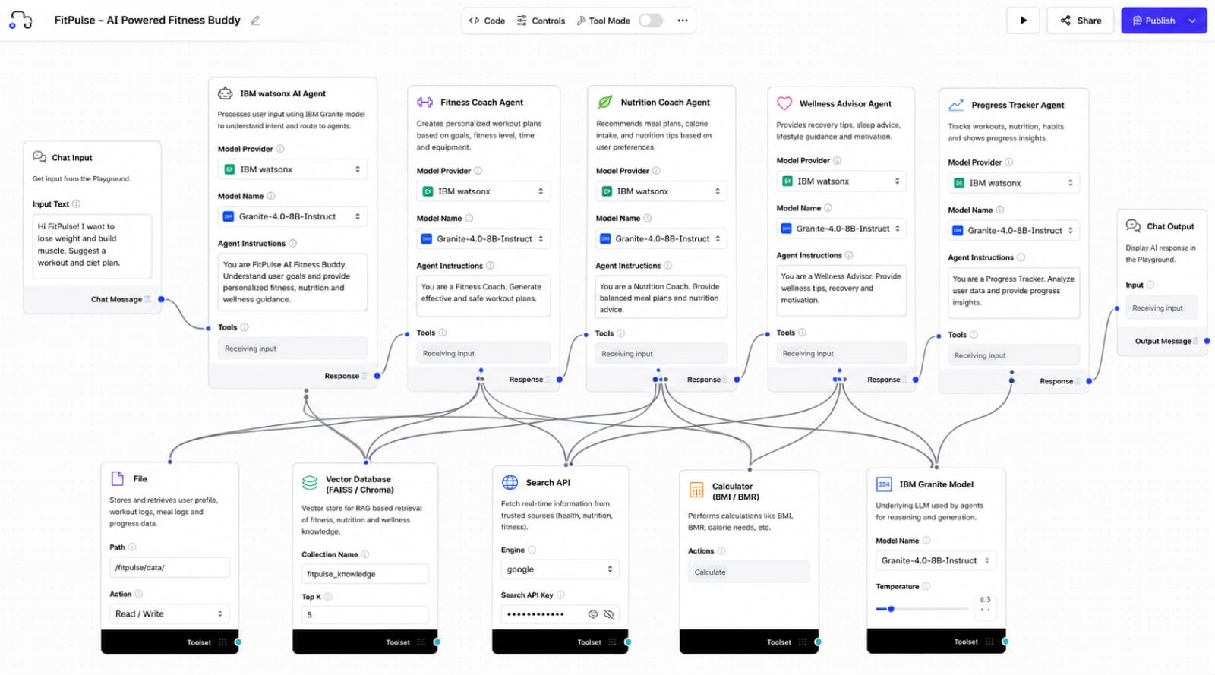
Langflow workflow -

Slide 8
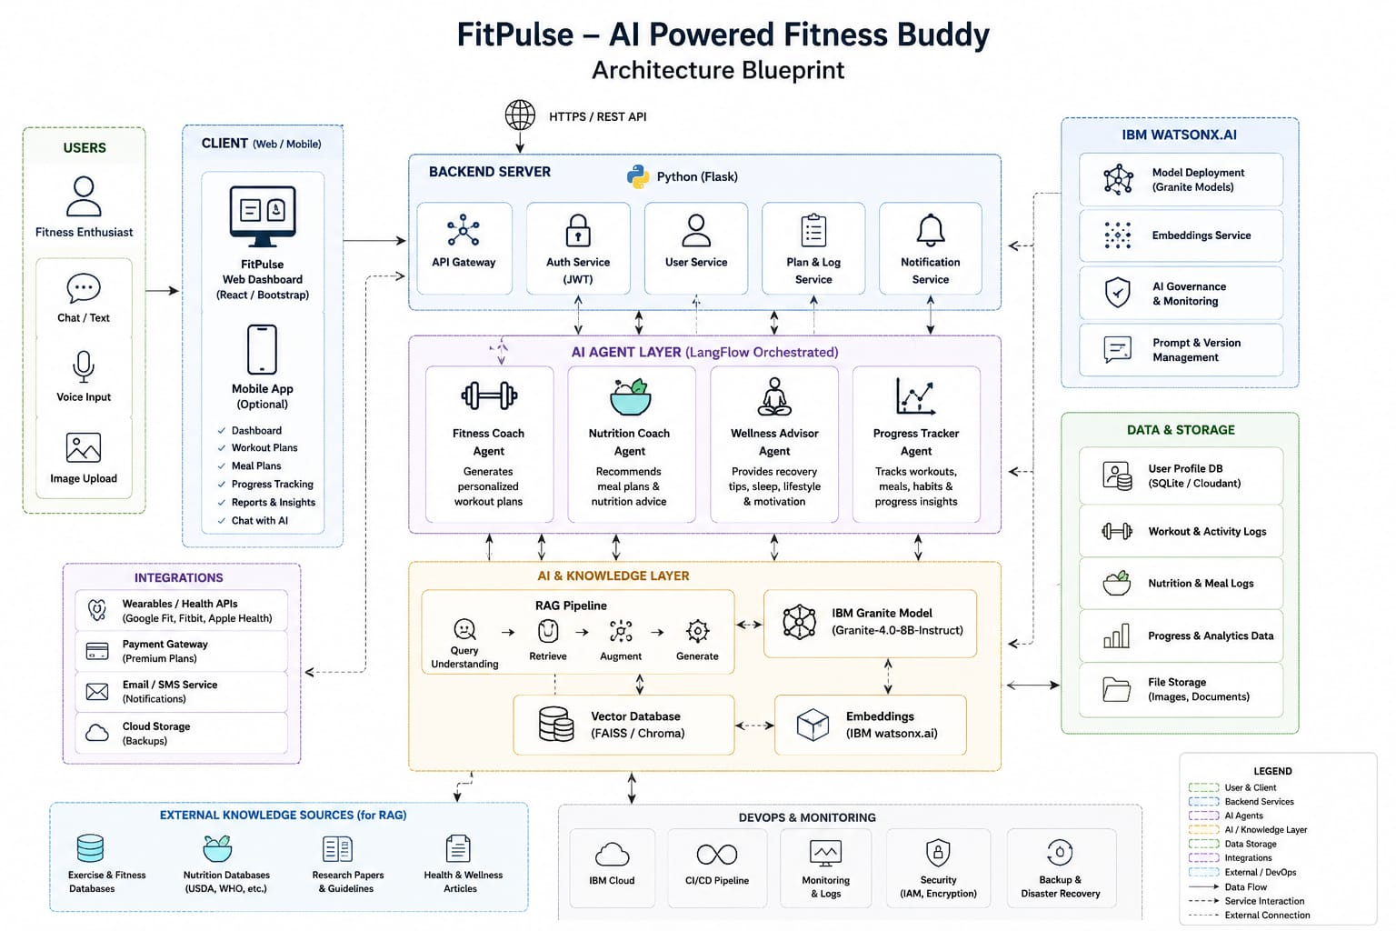
Architecture blueprint

Slide 9
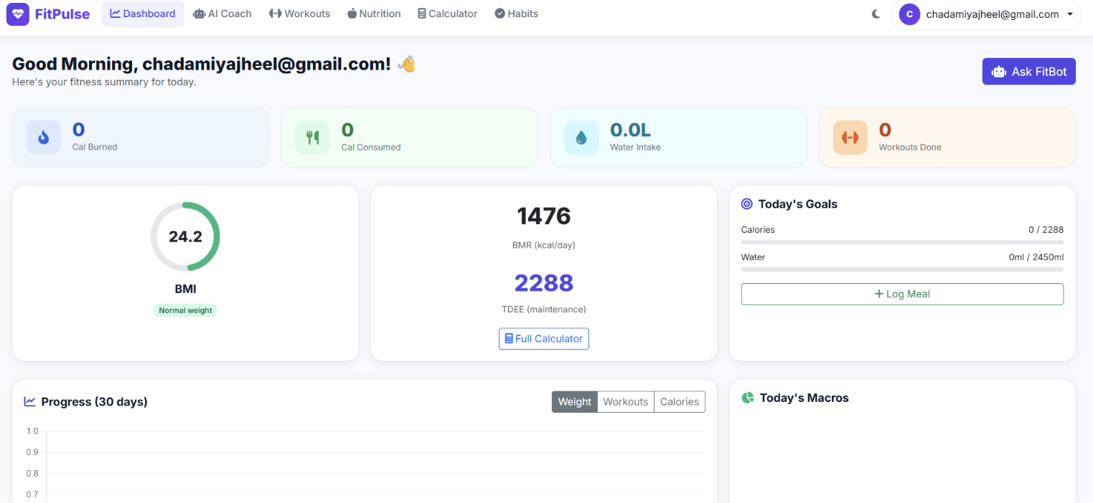

Slide 10
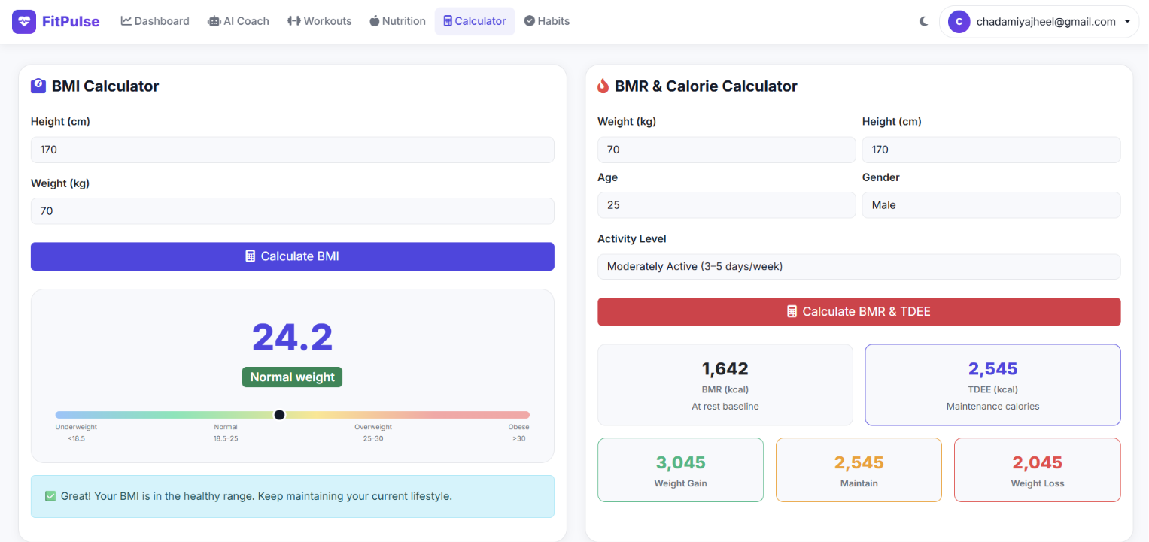

Slide 11
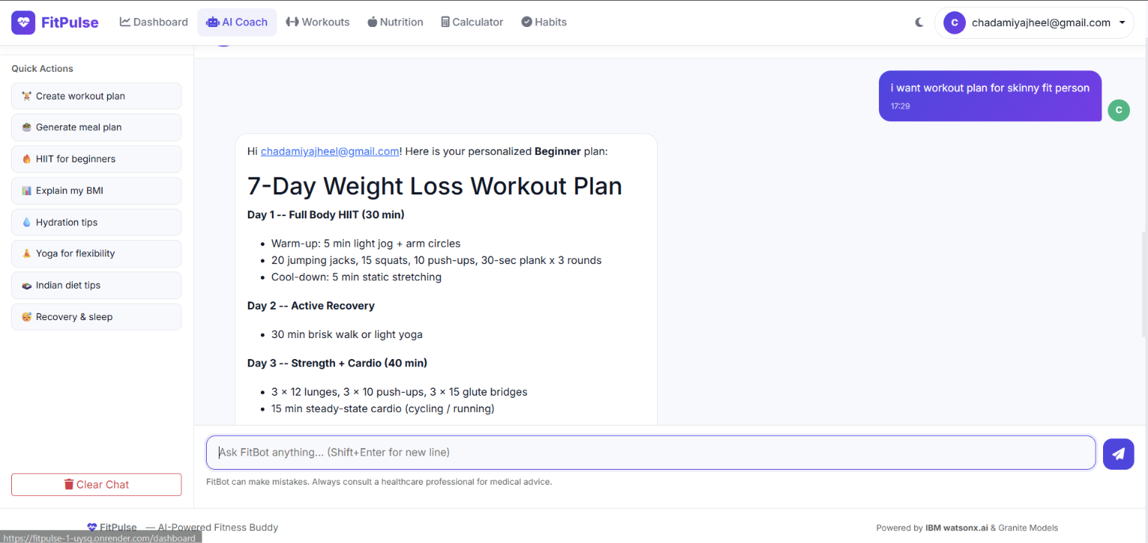

Slide 12
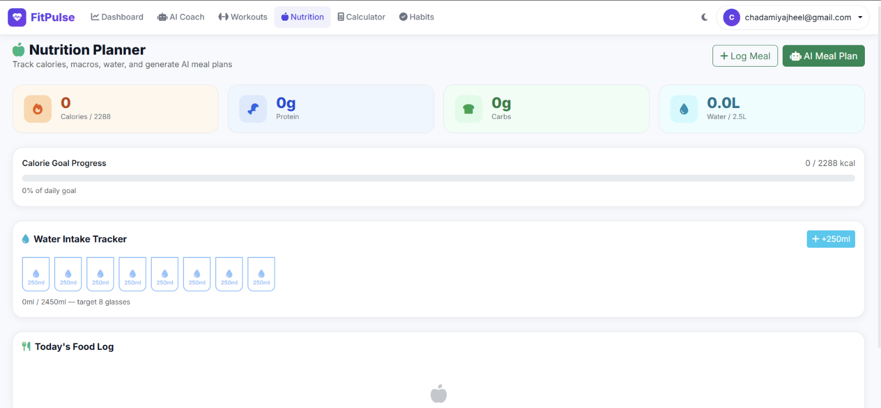

Slide 13

Role of Agentic AI in the solution
Agentic AI enables FitPulse to act as an intelligent fitness companion rather than a simple chatbot. Powered by IBM watsonx.ai and IBM Granite models, it coordinates multiple specialized agents to provide personalized workout plans, nutrition guidance, wellness advice, and progress tracking.
Each agent performs a specific task while collaborating with others to deliver accurate, context-aware recommendations based on the user's fitness goals, activity level, and preferences. The system continuously adapts its suggestions using user progress and habit data.
Overall, Agentic AI makes FitPulse proactive, personalized, and goal-driven, helping users stay consistent and achieve their fitness and wellness goals.

Slide 14
Novelty and Uniqueness
The proposed Nutrition Agent stands out by combining Agentic AI, RAG, and personalization into a single intelligent system.
Multi-Agent Intelligence – Instead of a single chatbot, multiple specialized agents collaborate to deliver accurate and context-aware nutrition guidance.
RAG-Based Accuracy – Integrates real-time data retrieval with AI generation, reducing misinformation and ensuring trustworthy recommendations.
Hyper-Personalization – Tailors diet plans based on health conditions, cultural preferences, and fitness goals.
Real-Time Feedback Loop – Continuously adapts recommendations based on daily food logs and user behavior.
Multi-Modal Input – Supports text, voice, and image-based meal tracking for better usability.
Preventive Healthcare Focus – Goes beyond diet planning to provide disease-specific nutrition advice.
Scalable & Enterprise-Ready – Built on IBM watsonx.ai with IBM Granite models, ensuring reliability and governance.
This makes the solution a smart, adaptive, and proactive digital nutritionist, not just a static diet recommendation tool.

Slide 15
Git Hub Link
Git hub repository link -: https://github.com/Chadamiya-Jheel/FitPulse
Live render Link -: https://fitpulse-1-uysq.onrender.com

Slide 16
Future Scope
Integration with Wearables & Fitness Devices FitPulse can be integrated with smartwatches and fitness trackers to collect real-time data such as steps, heart rate, calories burned, sleep patterns, and workout activity. This will enable the AI to provide more accurate, personalized, and dynamic fitness recommendations.
2. AI Voice Coach & Multilingual Support Future versions can include a voice-enabled AI fitness coach with support for
multiple languages, allowing users to interact naturally in their preferred
language. This will improve accessibility and make FitPulse more inclusive
for users from diverse backgrounds.
·
·
·

Slide 17
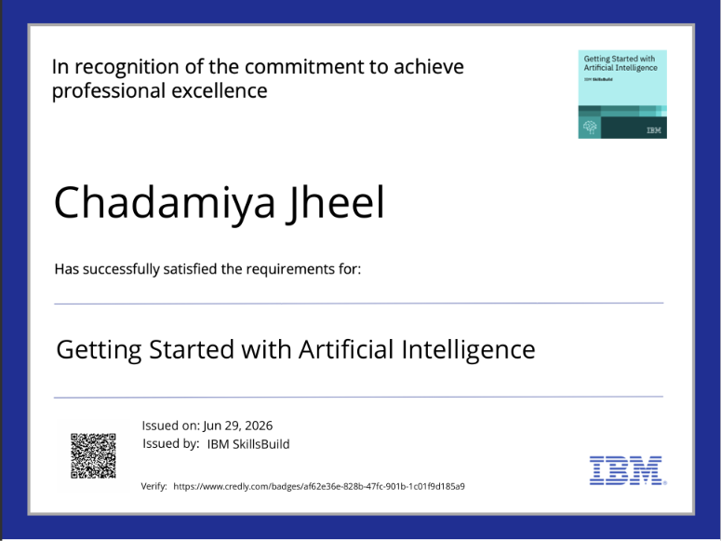
Certificates Earned:

Slide 18


Slide 19


Slide 20
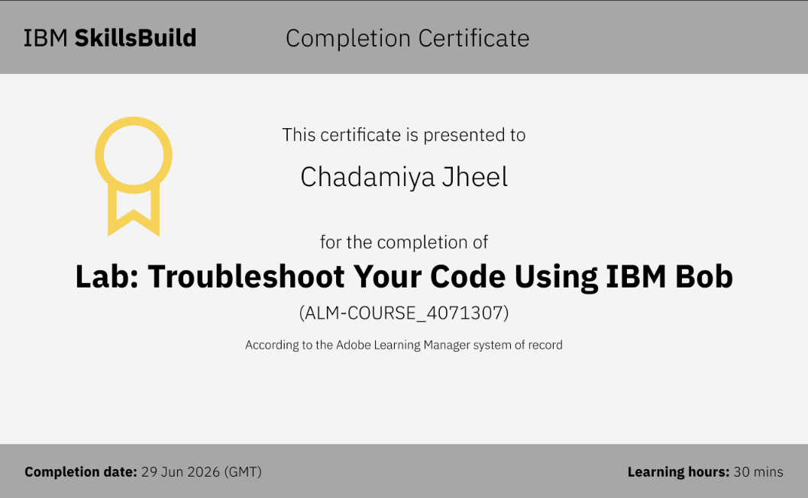
Certificates Earned:​

Slide 21


